Slide 1
The zombie hunt
- TV-show - calculating without calculator - bookshop

Slide 2
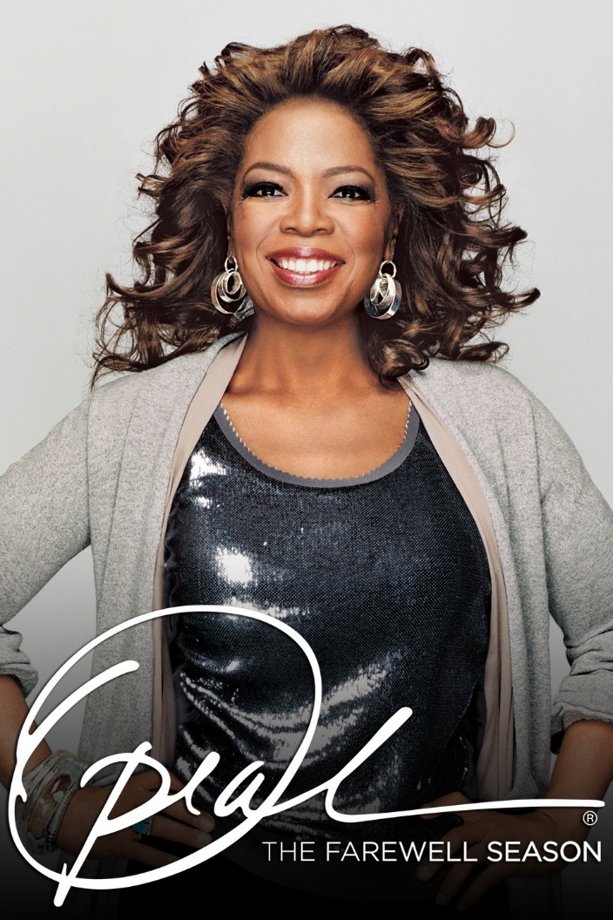
Oprah show
It is an American talk show that aired nationally for 25 seasons from September 8, 1986 to May 25, 2011. Although the recording ended 6 years ago, fans continue to watch the show on YouTube and many channels still broadcast Oprah show.

Slide 3
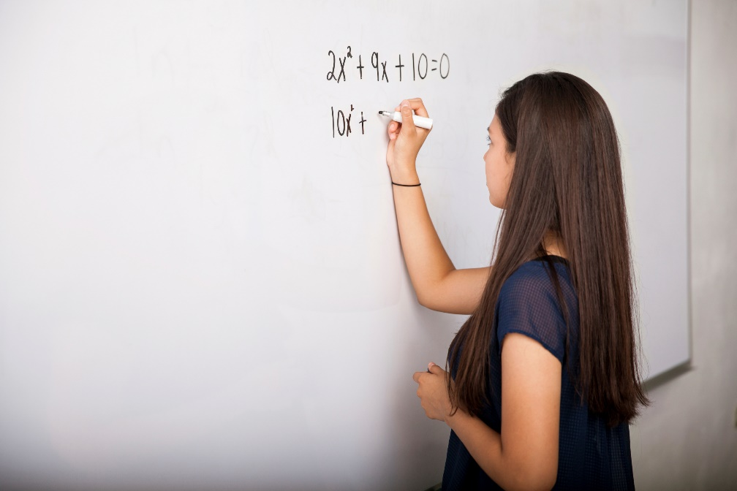
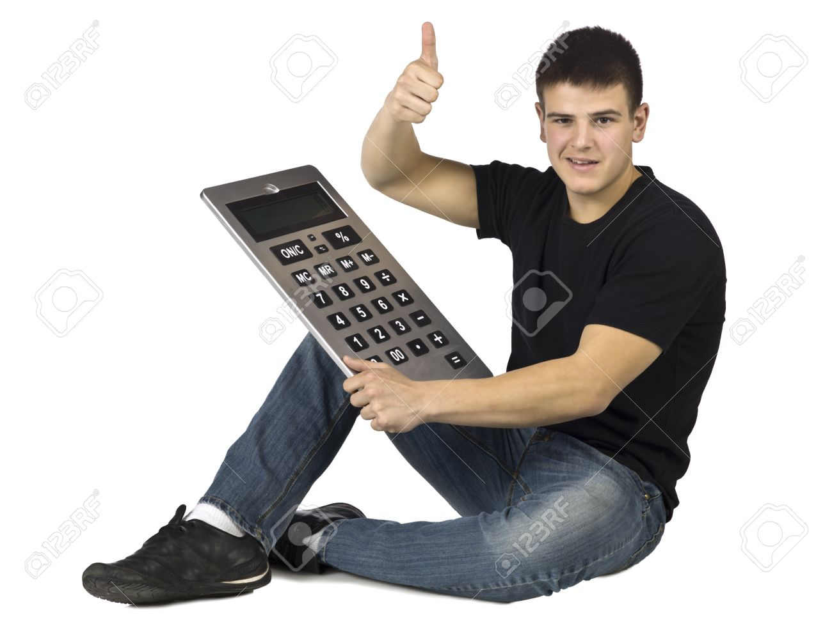
Calculating instead of calculator
In many schools teachers use the old way of teaching Maths. Children must know how to multiply by heart even thought there is a calculator.

Slide 4
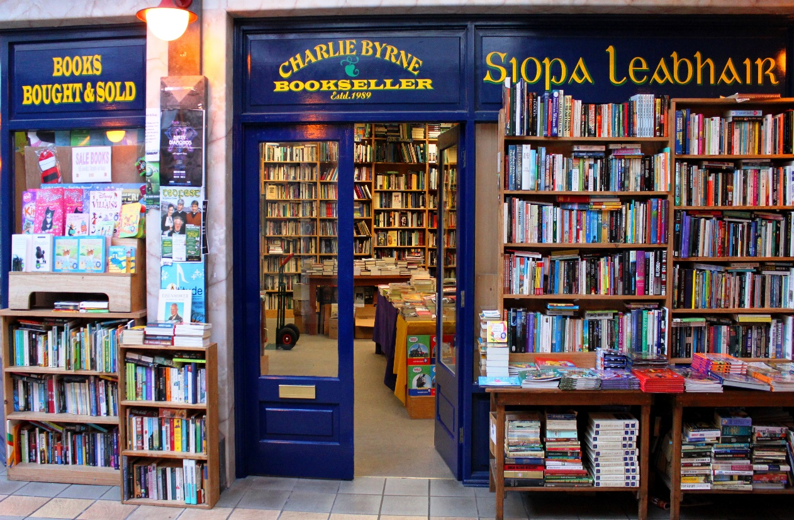
Bookshops
Although most people began to read books on the Internet, there are still many bookshops in towns. In my opinion, reading “real” books and collecting them at home is better way. But not many people think the way I do. So, bookshop employees, maybe it is time to start a new business?

Slide 5
Driving Forces
Oprah is a zombie because of the human closeness with other people’s lives. People know Oprah for 25 years and they think she is the part of their life.
Calculating is a zombie because every man thinks that his/her generation is the smartest one and that the new generations are stupid because of the new technologies. Teachers just need to accept that it is better to use easier technologies and have less stressful lives.
Bookshops are zombie because it is easier to find a book, an encyclopedia, a cookbook etc. on Internet rather then drive a car or go for a walk to the bookshop. It is better to read free of charge rather then pay for it.

Slide 6
Countering forces
If you take a look at Oprah Winfrey's career, it's pretty obvious this woman has touched millions of people with her TV-show, movies and other entertainment properties including the OWN Magazine and Network. She has offered a staggering part of herself to others by encouraging people to be positive and live life to the fullest.
Calculating without calculator is still in our habits because we improve our logical skills in that way. Also we can figure out how to use a recipe for cooking or baking, learn to play an instrument, calculate how much will our new dress cost if there is additional 15% sale.
Turns out people still really like to go into a bookstore, to touch and enjoy looking though stacks of physical books, to chat with staff about what they like, (or hate), maybe listen to an author do a reading and then take audience questions and sign copies.

Slide 7
Own point of interests
I enjoy watching Oprah show again and again because every time I watch some episode I understand it in a different way. And every time I figure out something new.
I appreciate calculating because I was always good in Maths. All the people from my class thought I am some kind of freak, but when they were confused how to pay bill if there are 10 persons they decided to adore me :D
Reading a book is special feeling. It is not the same when you are watching the display, especially if you have eidetic memory. It is easier to choose what would you like to read when you see a book rather then searching for it on many web pages.

Slide 8
Summary
Maybe we should stop watching old TV-shows just because it is some kind of nostalgia for old times. There are so many new TV-shows that are worth watching.
Maybe we should stop believing that calculating is the only way to improve logical skills. Just give new generations calculator and believe they will improve their skills in some other way.
Find books on internet free of charge and save that money for some other good things in life.

